Slide 1

Data Structures
Asymptotic Notations
Subin Sahayam, Assistant Professor,
Department of Computer Science and Engineering
Shiv Nadar University

Slide 2
Last Class Summary
Last Class Summary
Introduction to C++
Today's Course Outcome

Slide 3
Efficiency
What are the general part of a computer?
K1

Slide 4
Efficiency
What are the general part of a computer?
Processor
Memory
Input/Output Devices
K1

Slide 5
Efficiency
What are the general part of a computer?
Processor
Memory
Input/Output Devices
What is limited?
K1

Slide 6
Efficiency
What are the general part of a computer?
Processor
Memory
Input/Output Devices
What is limited?
Processing Time (Eg: GHz)
Memory Size (Eg: GB)
Communication Bandwidth (Eg: bps)
Power Consumption (Eg: W)
K2

Slide 7
Efficiency
What are the general part of a computer?
Processor
Memory
Input/Output Devices
What is limited?
Processing Time (Eg: GHz)
Memory Size (Eg: GB)
Communication Bandwidth (Eg: bps)
Power Consumption (Eg: W)
Optimization – Focus Limited Resources
K1

Slide 8
Efficiency
What are the general part of a computer?
Processor
Memory
Input/Output Devices
What is limited?
Processing Time (Eg: GHz)
Memory Size (Eg: GB)
Communication Bandwidth (Eg: bps)
Power Consumption (Eg: W)
Optimization – Focus Limited Resources
Data Structures - Logical + Efficient Data Storage + Organization + Retrieval
K1

Slide 9
Questions?

Slide 10
Measuring Performance
A company has a computational problem 'x'.
K2

Slide 11
Measuring Performance
A company has a computational problem 'x'.
Engineer 1 comes up with a solution 's1'.
Engineer 2 comes up with a solution 's2'.
K2

Slide 12
Measuring Performance
A company has a computational problem 'x'.
Engineer 1 comes up with a solution 's1'.
Engineer 2 comes up with a solution 's2'.
's1' - computer 'c1' takes 5 seconds.
's2' - computer 'c2' takes 20 seconds.
Can you choose 's1' for deployment?
K2

Slide 13
Measuring Performance
A company has a computational problem 'x'.
Engineer 1 comes up with a solution 's1'.
Engineer 2 comes up with a solution 's2'.
's1' - computer 'c1' takes 5 seconds.
's2' - computer 'c2' takes 20 seconds.
Can you choose 's1' for deployment?
Processing constants (Hardware)
Algorithmic constants (Software)
K2

Slide 14
Measuring Performance
A company has a computational problem 'x'.
Engineer 1 comes up with a solution 's1'.
Engineer 2 comes up with a solution 's2'.
's1' - computer 'c1' takes 5 seconds.
's2' - computer 'c2' takes 20 seconds.
Can you choose 's1' for deployment?
Processing constants (Hardware)
Algorithmic constants (Software)
Goal: Get rid of constants
K2

Slide 15
Questions?

Slide 16
Measuring Performance
Asymptote?
K2

Slide 17
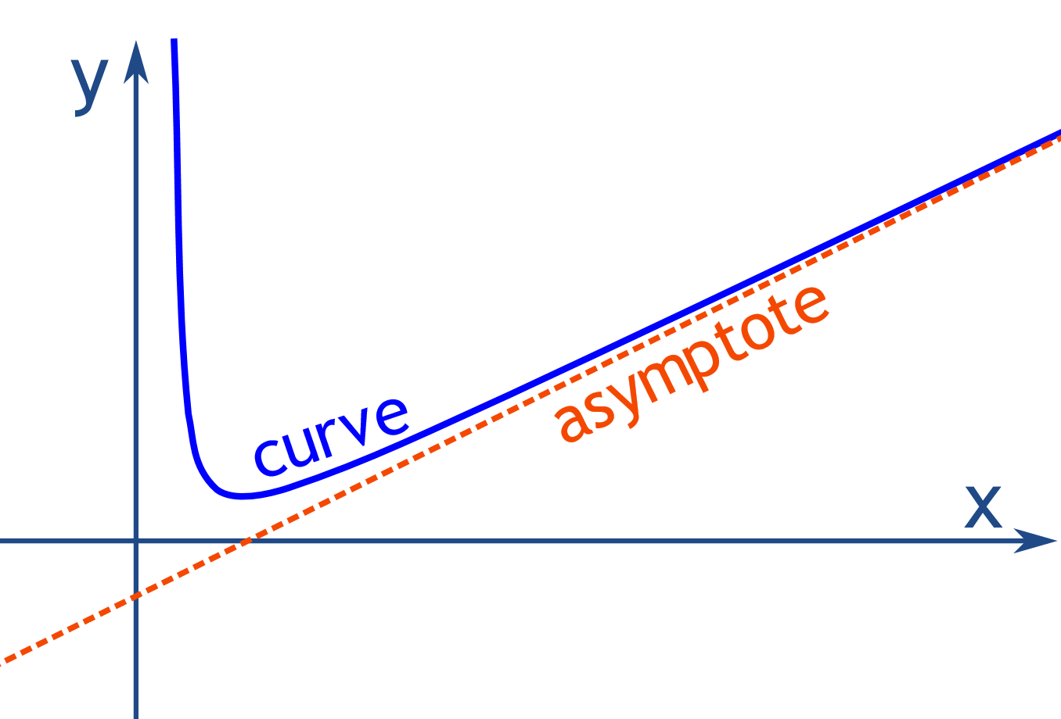
Measuring Performance
Asymptote?
K2

Slide 18
Measuring Performance
Let's say magically, the solution 's1' can be mathematically represented as the following function,
f1(n) = 5 * n²
The solution 's1' can be mathematically represented as the following function,
f2(n) = 20 * n
Where n is the input size.
K2

Slide 19
Measuring Performance
f1(n) = 5 * n²
f2(n) = 20 * n
Input size n | Cost of f1(n) | Cost of f2(n)
1 | 5 | 20
2 | 20 | 40
3 | 45 | 60
4 | 80 | 80
5 | 125 | 100
K2

Slide 20
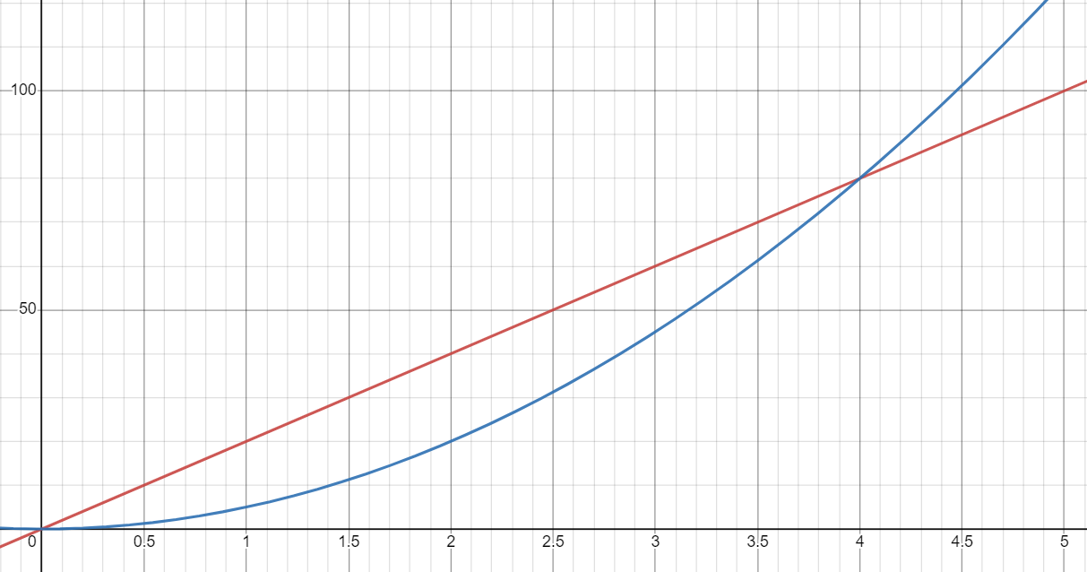
Measuring Performance
f1(n) = 5 * n²
f2(n) = 20 * n
f1(n)
f2(n)
n₀
K2

Slide 21
Measuring Performance
f1(n) = 5 * n²
f2(n) = 20 * n
Problem:
You may not always have 2 functions for comparison
K2

Slide 22
Measuring Performance
f1(n) = 5 * n²
f2(n) = 20 * n
Problem:
You may not always have 2 functions for comparison
Solution:
Reference function - g(n)
K2

Slide 23
Measuring Performance
Consider:
f(n) = n + n²
Reference function g(n)
Compare f(n) and g(n)
Goal: Get rid of constants
K2

Slide 24
Measuring Performance
Consider:
f(n) = n + n²
Reference function g(n)
Compare f(n) and g(n)
Goal: Get rid of constants
f(n) com c*g(n)
K2

Slide 25
Measuring Performance
Consider:
f(n) = n + n²
Reference function g(n)
Compare f(n) and g(n)
Goal: Get rid of constants
f(n) com c*g(n)
What possible comparisons?
K2

Slide 26
Measuring Performance
Consider:
f(n) = n + n²
Reference function g(n)
Compare f(n) and g(n)
Goal: Get rid of constants
f(n) com c*g(n)
What possible comparisons?
f(n) <= c*g(n)
f(n) >= c*g(n)
c1*g(n) <= f(n) <= c2*g(n)
f(n) < c*g(n)
f(n) > c*g(n)
K2

Slide 27
Measuring Performance
Consider:
f(n) = n + n²
What values can g(n) take?
K2

Slide 28
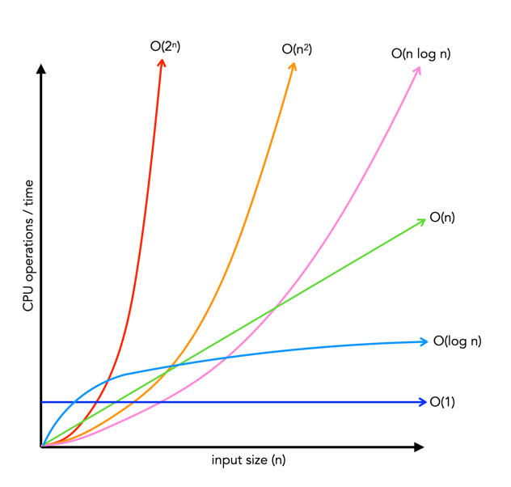
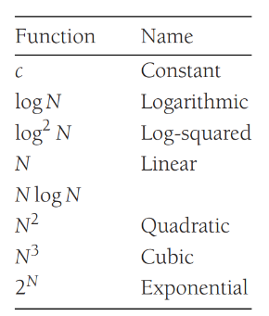
Growth Rates
K2

Slide 29
Remember n₀
f1(n) = 5 * n²
f2(n) = 20 * n
f1(n)
f2(n)
n₀
K1

Slide 30
Overview
Consider:
f(n) = n + n²
Reference function g(n)
Compare f(n) and g(n)
Goal: Get rid of constants
f(n) <= c*g(n)
f(n) >= c*g(n)
c1*g(n) <= f(n) <= c2*g(n)
f(n) < c*g(n)
f(n) > c*g(n)
Find c > 0, Find n₀ <= n
K2

Slide 31
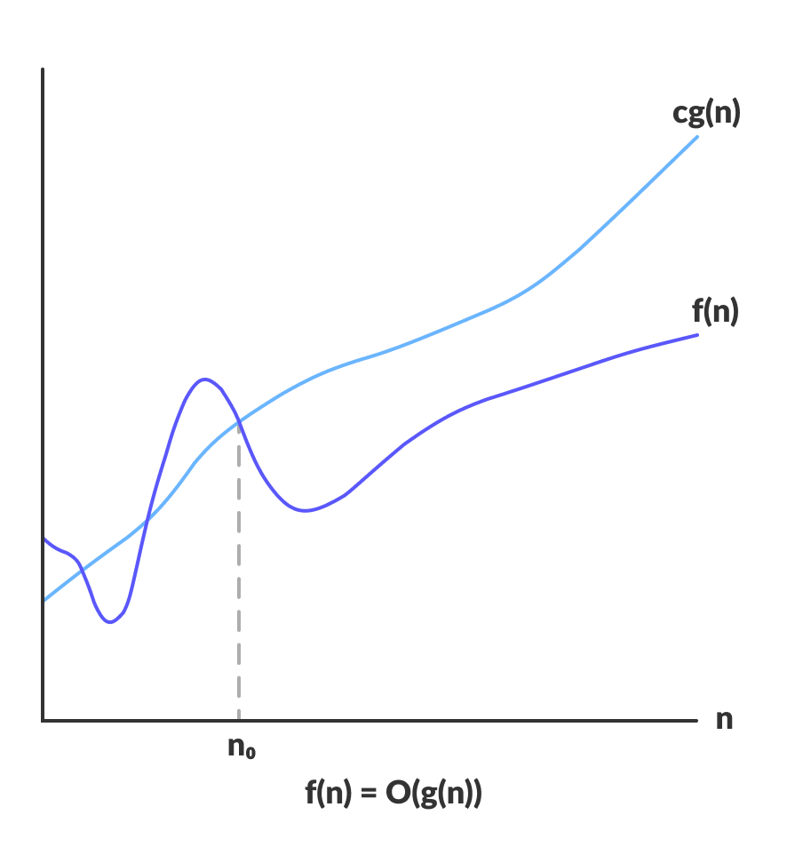
Big Oh
K2

Slide 32
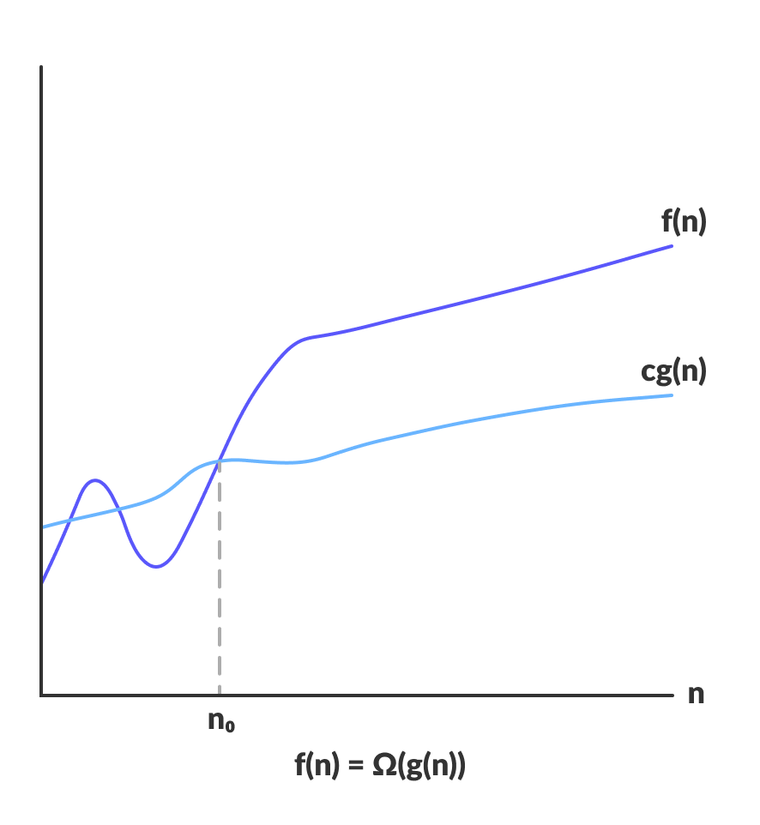
Big Omega
K2

Slide 33
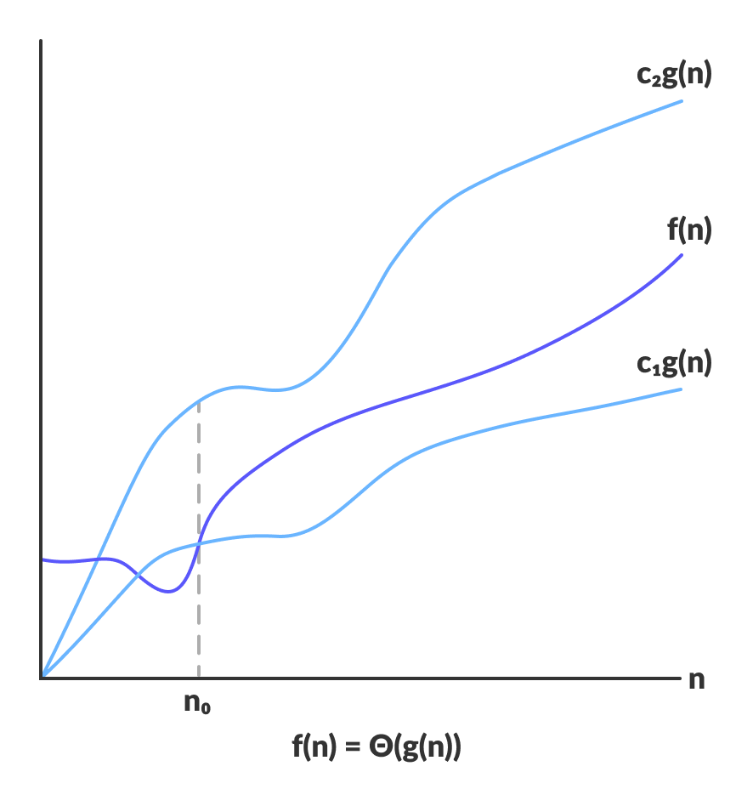
Theta
K2

Slide 34
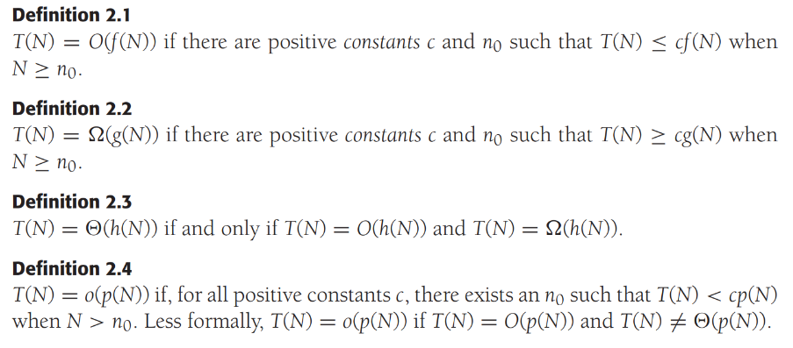
Definitions
K1

Slide 35
Today's Course Outcomes
CO1 – Apply abstraction and the basics of complexity analysis – K3
CO2 – Apply various linear data structures to store and retrieve data – K3
CO3 – Apply various non- linear data structures to store and retrieve data – K3
CO4 - Analyze the time and space complexity of various data structures – K4
CO5 – Evaluate across various data structures for a given context – K5
K1

Slide 36
Summary
Last Class Summary
Efficiency
Measuring Performance
Growth Rates
Remember n₀
Overview
Big-Oh
Big-Omega
Theta
Definitions
Today's Course Outcome

Slide 37
References
Allen, Weiss Mark. Data structures and algorithm analysis in C++. 4th Edition, Pearson Education India, 2016.
Cormen, Thomas H., et al. Introduction to algorithms. MIT press, 2009.

Slide 38
THANK YOU

